Slide 1
Computer Science
Mr. Eddie

Slide 2
Do Now

Slide 3

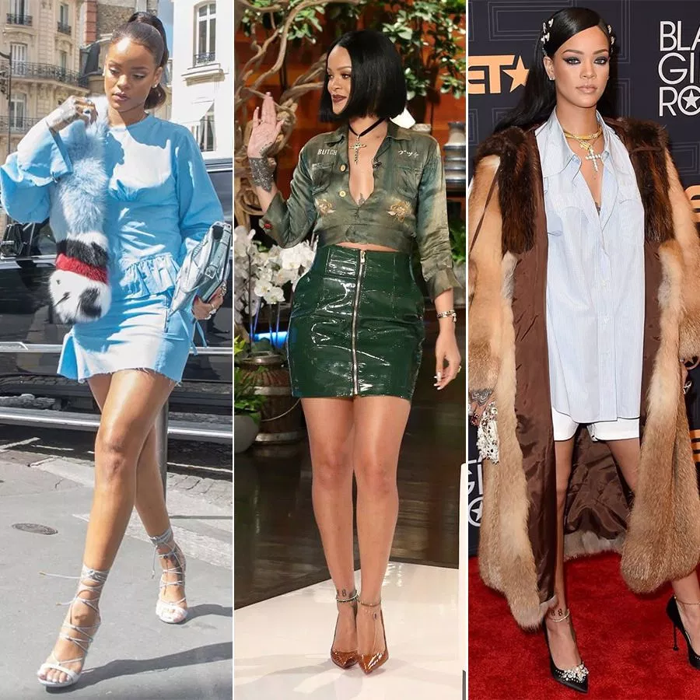
Do Now
Answer the posted questions in
If you were responsible for styling a celebrity for a red carpet event, what would you need to know before coming up with an outfit?
PS: It’s not RiRi, she’s already stylin’!💁🏽

Slide 4
Agenda

Slide 5



Agenda
Ciao
Do Now
Google Classroom
Objectives
Intro to CSS
Demo
Activity
Exit Ticket
Addio

Slide 6
Unit 1
Intro to HTML & CSS

Slide 7

Objectives
Understand the history of HTML, HTML as a computer language, and the many terms commonly used by developers.Add style to their web-pages using CSS (Cascading Style Sheets)
Understand how to link CSS documents to HTML in order to style their sites.

Slide 8
Introduction to CSS
CSS (Cascading Style Sheets) allows you to create great-looking web pages, but how does it work under the hood?
CSS is a language for specifying how documents are presented to users — how they are styled, laid out, etc.
CSS is a rule-based language — you define rules specifying groups of styles that should be applied to particular elements or groups of elements on your web page.
[example on next slide]

Slide 9
Style Attribute - No CSS
<html>
<head>...</head>
<body>
<h1 style=“color:red”>
Example
</h1>
</body>
</html>
Example

Slide 10
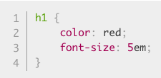
With CSS
Example
<html>
<head>...</head>
<body>
<h1>Example</h1>
</body>
</html>

Slide 11
Live Demo

Slide 12
Activity #1

Slide 13
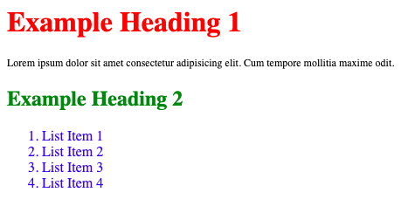
Activity#1: Add some style
1 H1 Heading: Red
1 H2 Heading: Green
1 Paragraph: Size 12px
1 Unordered List with 4 items: Items should be blue

Slide 14
Exit Ticket
Submit the link to your Activity via Google Classroom

Slide 15
Addio
[Good-Bye in Italian]

